Slide 1
Automatic Coconut Breaking, Scraping, and Grinding Machine
IN 1900 (ICT Project)
Final Presentation
Group No:15

Slide 2





Group Members
 | Name | Registration Number | Photo
Group leader | Nusky M.N.N. | 204146L
Member 1 | Banu A.G.S. | 204018X
Member 2 | Karunaweera R.L. | 204096G
Member 3 | Kumarasingha H.J.A. | 204108A
Member 4 | Lamahewage D.R. | 204114M

Slide 3
Outline
Problem in brief
Project Aim and Objectives
Proposed Solution
3D Diagram
3D Animation
Circuit Diagram
PCB Design
Resource Requirements
Cost Estimation
Testing and implementation

Slide 4
Problem in brief
Hard & risky to break the coconut using a knife with our hand.
Difficult with scraping the coconut for a long time holding with the hands.
Taking time to cut, scrape and grind the coconut separately.
Have risk with handling the coconut through an unsafe machine.

Slide 5
Project Aim and Objectives
Aim
Design and develop an automated machine for the process of coconut breaking, scraping & grinding with a safety mechanism.
Objectives
To break the coconut and get the water separately.
To scrape the coconut.
To grind the coconut.
To maintain the process safely.

Slide 6
Proposed Solution
Inputs
Process
Outputs
Text and numbers
Display
Numbers
Analyze the user inputs and starting the coconut breaking process.
Sound
Keypad
Buzzer
Distance (Water level)
Rotate the motor
DC motor
Rotating the cut disk, coconut scraper and blender
Ultrasonic sensor
Analyze the water level of the water tank and send signals to the buzzer.
Detection (of the cut disk)
Rotate the motor
Servo motor
Pointing the coconut fixing handle towards the coconut scraper
IR sensor
Starting the process of coconut scraping and grinding after analyzing the signal of the IR sensor, and color sensor and sending signals to Servomotor, DC motor, and blender system.
Detection (of the color)
Rotate the motor
Color Sensor
Stepper motor
Moving the cut disk up and down.
Grinding
Blender system
Atmega 32 Microcontroller

Slide 7

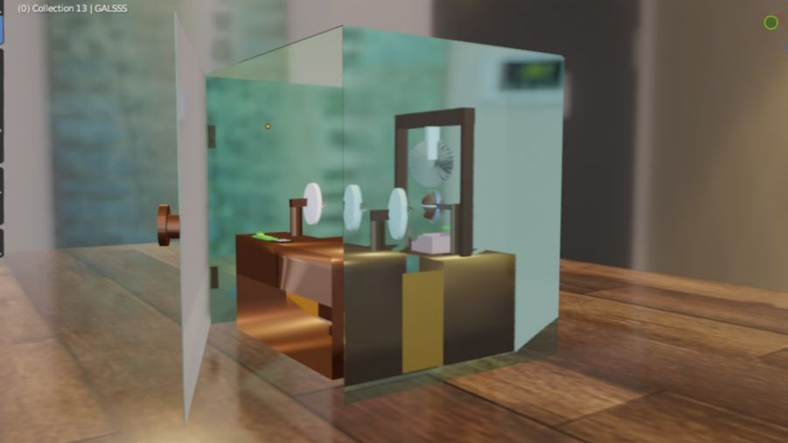
3D Diagram
Glass box
Blender
Figure 1 -Front view
Figure 2 –Right side view

Slide 8
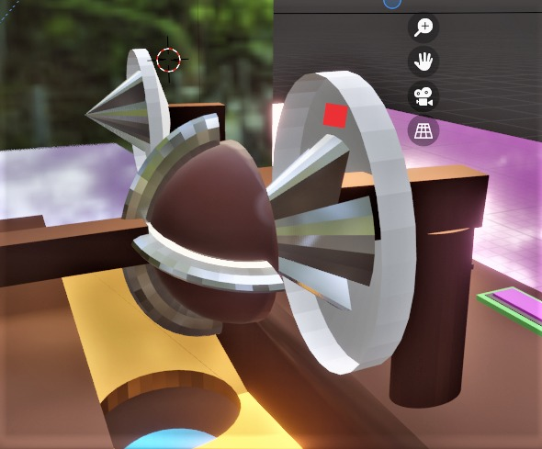
3D Diagram
Color sensor
Figure 3 -Side view

Slide 9

3D Animation
Link for 3D Animation: https://drive.google.com/file/d/1ILcT4oXj9GX8DXqPTRbnsRM1xtLKLiQE/view?usp=drivesdk

Slide 10
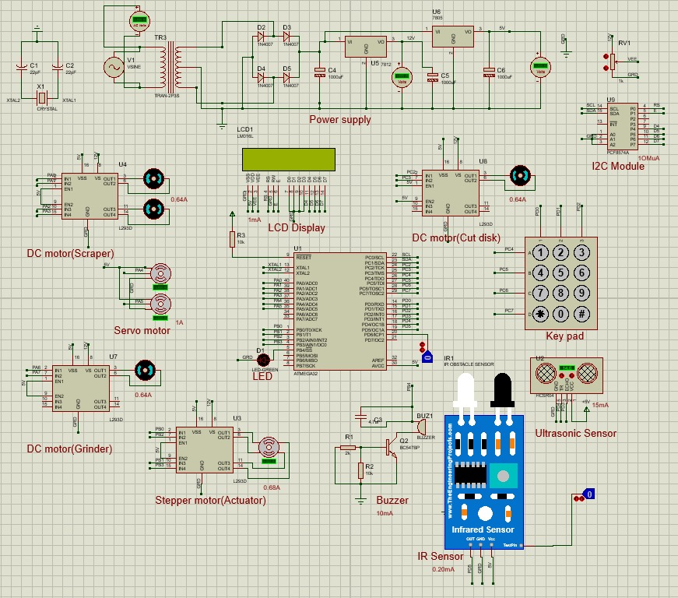
Circuit Diagram
Figure 4 –Circuit Diagram(Labeled)

Slide 11
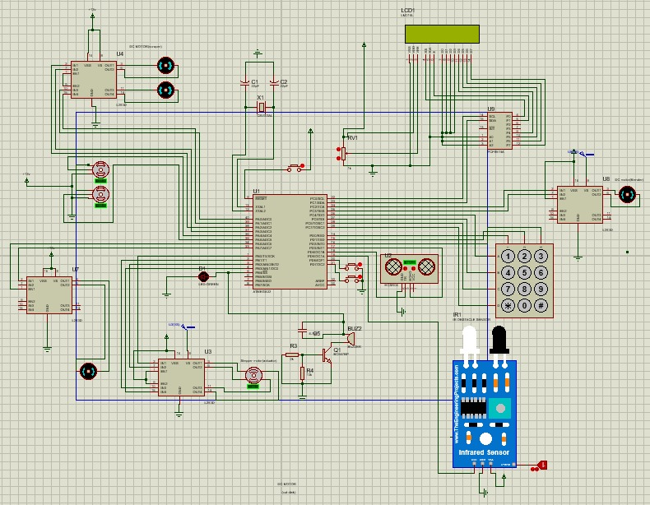
Circuit Diagram
Figure 5 –Circuit Diagram(Connected)

Slide 12
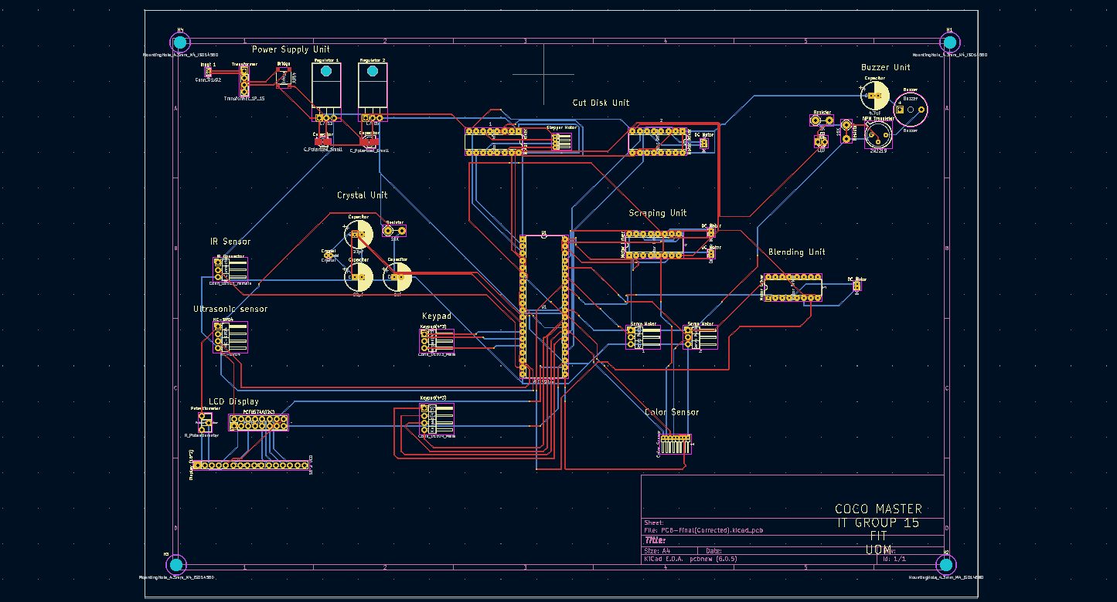
PCB Design
Figure 6 –PCB Design

Slide 13
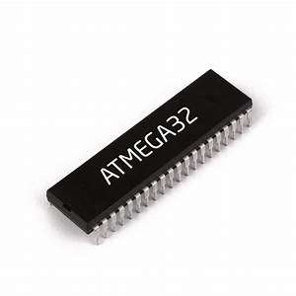

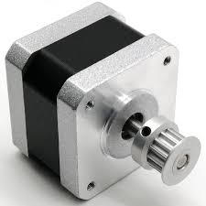
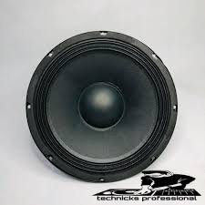
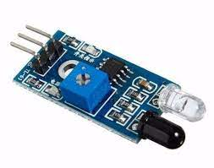
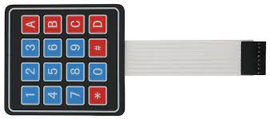
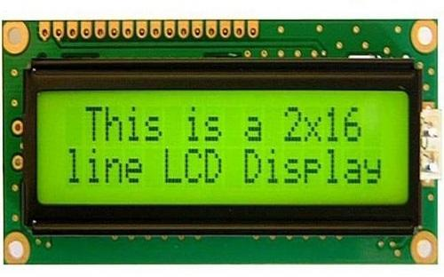
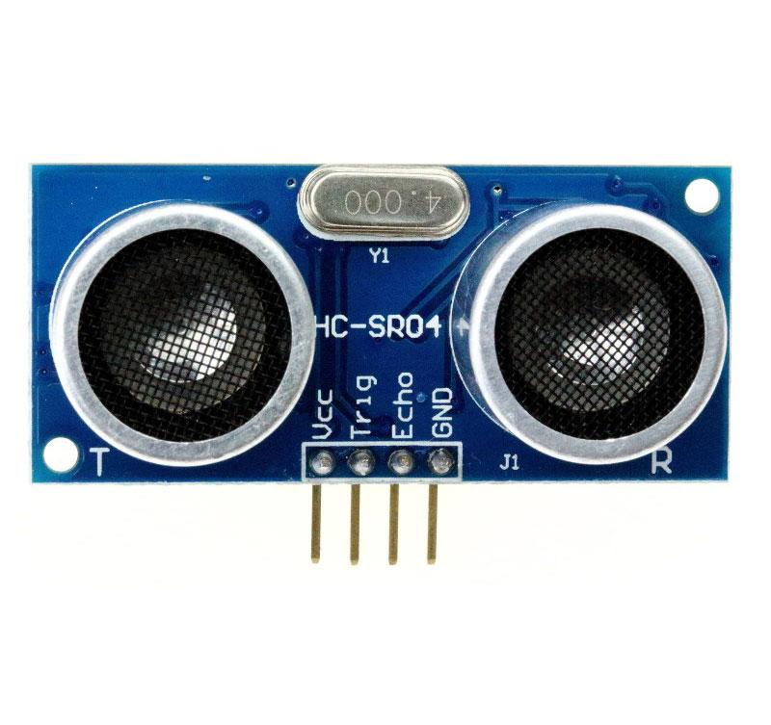
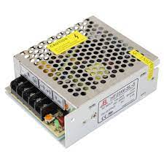
Resources Requirements
Software:
Atmel Studio
Proteus software
Blender software
Kicad software
Hardware:
Microcontroller: Atmega32
IR Sensor
Ultrasonic sensor
Keypad
Buzzer
Display
Stepper motor
Servo motor
DC motor
Push button
Blender system
Color sensor

Slide 14
Cost Estimation
Item | Quantity | Price (Rs) | Subtotal (Rs)
Atmega32 | 1 | 1100 | 1100
IR sensor | 1 | 150 | 150
Ultrasonic sensor | 1 | 350 | 350
Buzzer | 1 | 400 | 400
Keypad (4*3) | 1 | 260 | 260
Display (2*16) | 1 | 840 | 840
Push button | 1 | 40 | 40
Servo motor | 2 | 600 | 1200
Stepper motor | 1 | 1000 | 1000
DC motor | 4 | 1250 | 5000
Color sensor | 1 | 1500 | 1500
Motor drivers | 4 | 780 | 3120
I2C module | 1 | 340 | 340
Finishing | 1 | 3000 | 3000
Total |  |  | 18300
Figure 7 – Estimated cost

Slide 15
Individual Contribution & Responsibilities
Member 1 – Nusky M.N.N.(204146L)
Individual Contribution
Designing and programming the Ultrasonic sensor and LCD modules.
Responsibilities
To study the basic microcontroller concepts.
To study the simulation software and programming software.
To design and program Ultrasonic sensor and LCD modules.

Slide 16
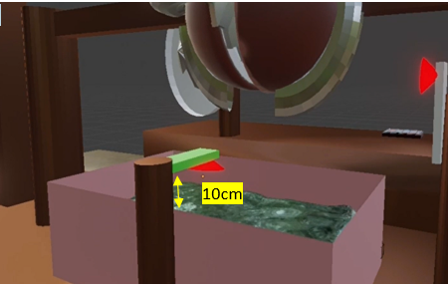
Technique – Ultrasonic sensor
We used the ultrasonic sensor to identify whether the coconut water overflowed or not.
We fixed ultrasonic sensors in the 10 cm height above the tank.
When a distance (height) below 15 cm ultrasonic sensor is given a signal to the buzzer, and it will be given to signal to the display.
Link to Datasheet:https://drive.google.com/file/d/1Ymw2fadnO43F6_2x_IDgbpbXdpRz8Obt/view?usp=sharing

Slide 17
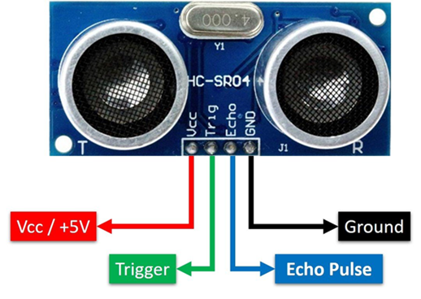
Specification
Ultrasonic sensor
Working voltage: 5V DC
Working current: 15mA
Distance range : 2 - 400cm
Measuring angle: 15 degrees
Trigger input pulse: 10 micro-seconds

Slide 18
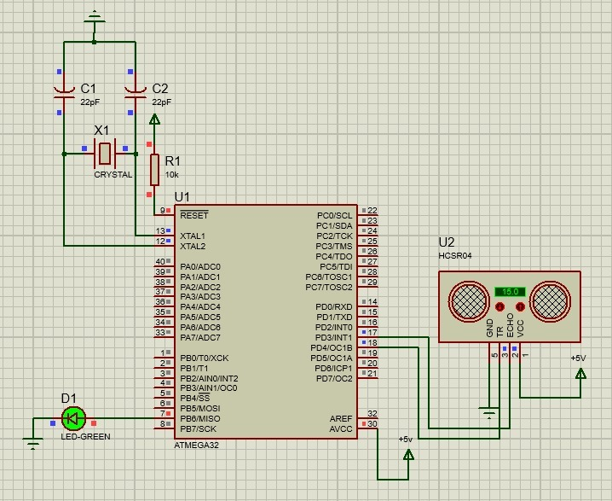
Schematic Diagram
Figure 8 – Ultrasonic sensor

Slide 19
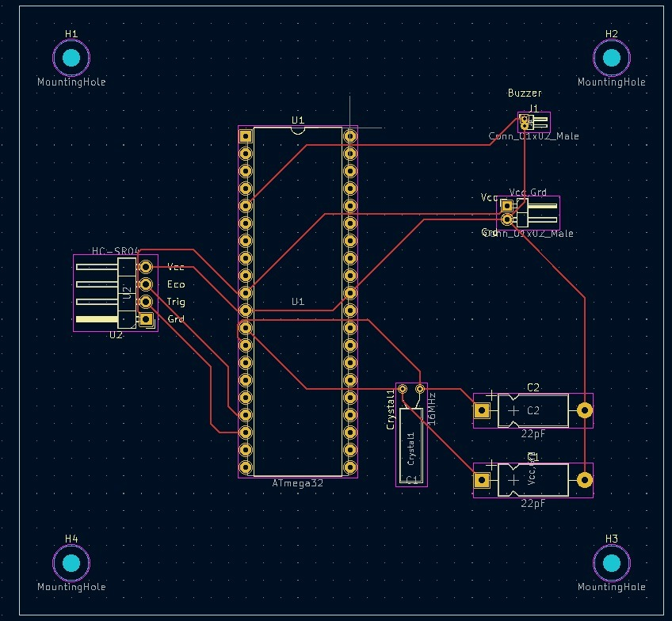
PCB Design
Figure 9 – Ultrasonic sensor

Slide 20
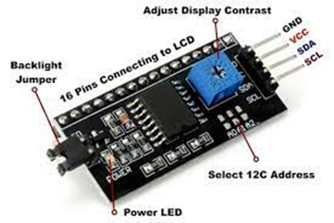
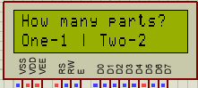
Technique - LCD
We use an LCD display (16*2) for displaying what the process is at the time on our machine.
To get the inputs from the user at a specific time.
PCF8574A(I2C MODULE)
8bit interface
Link to Datasheet:https://drive.google.com/file/d/1bBXTxMkjncLkXHWZvU7HxjIdOrhehP2g/view?usp=sharing

Slide 21
Specification
LCD
Operating voltage of the LCD is 4.7V – 5.3V
The utilization of current is 1mA with no backlight.
The display bezel is 72 x 25mm.
Number of columns – 16
Number of rows – 2.
It can display 32 characters at a time.
I2C Module
Number of input outputs - 8
Features - Interrupt pin
Supply voltage - 2.5V-6V
Low standby-current consumption of 10 μA max.
Addresses - 8
Frequency (Max) - 100kHz
Operating temperature range (C) - 40 to 85

Slide 22
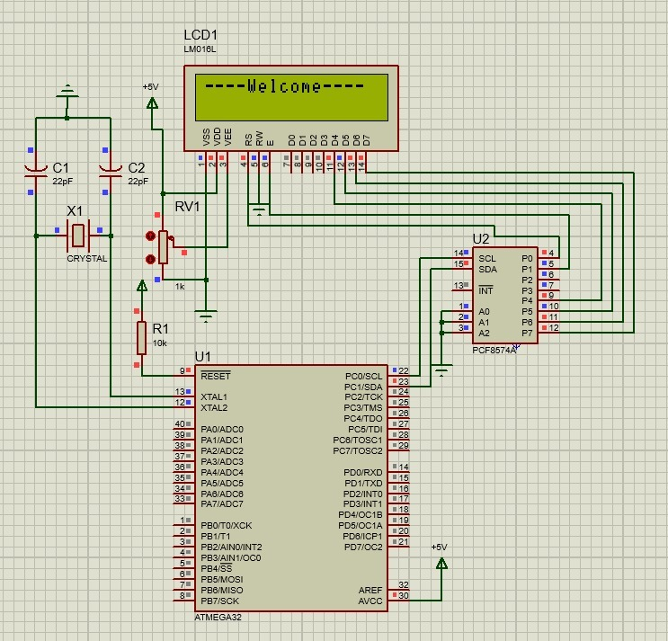
Schematic Diagram
Figure 10 – LCD

Slide 23
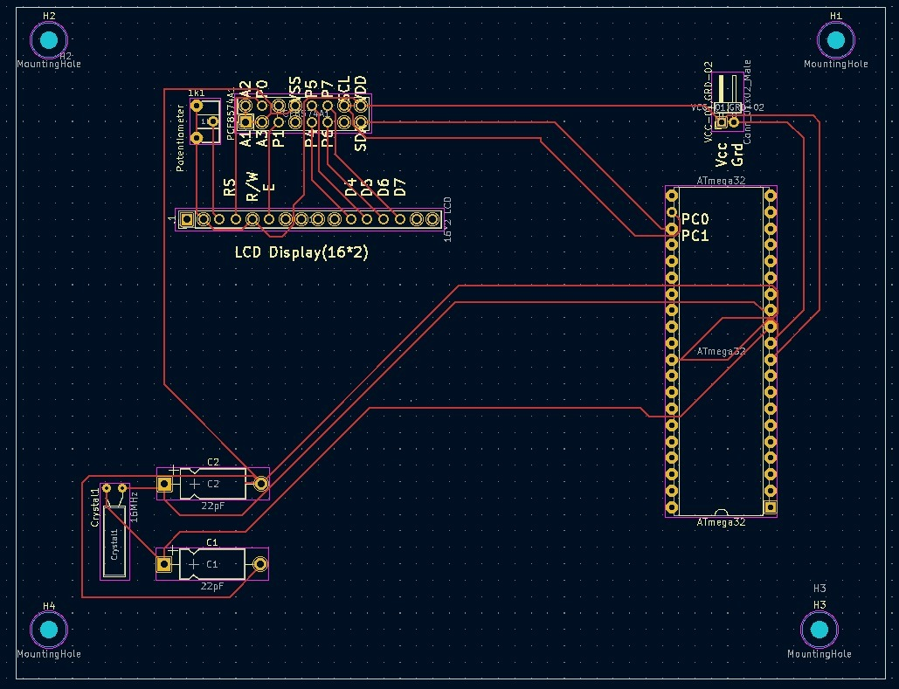
PCB Design
Figure 11 – LCD

Slide 24
Individual Contribution & Responsibilities
Member 2 – Karunaweera R.L.(204096G)
Individual Contribution
Designing and programming the servo motor and buzzer modules.
Responsibilities
To study the basic microcontroller concepts.
To study the simulation software and programming software.
To design and program servo motor and buzzer modules.

Slide 25
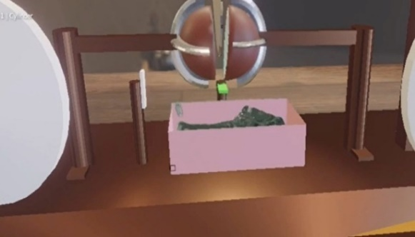
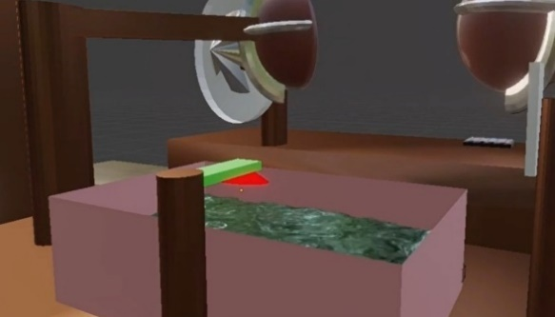
Technique – Servo Motor
Servo motor controls the coconut fixing handles.
Servo motor points the coconut fixing handle towards the scraper by turning it 90 degrees.
Holding it thereafter till the coconut scraping is finished.
I selected SG Tower pro 90 Motor for our project.
Link to Datasheet: https://components101.com/motors/servo-motor-basics-pinout-datasheet

Slide 26
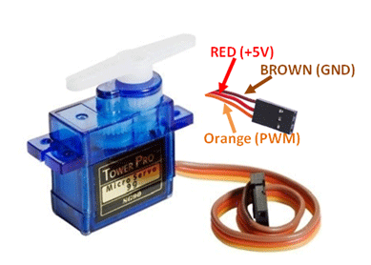

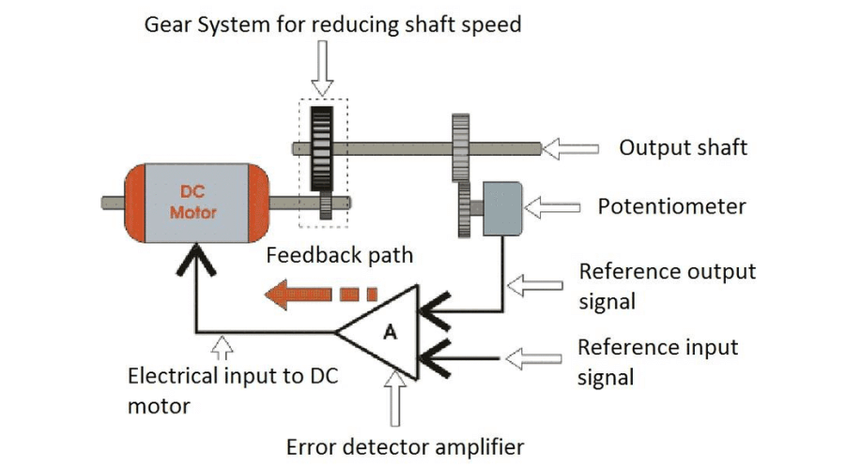
Specification
Servo Motor(SG Tower Pro 90)
Operating Voltage is +5V typically
Torque: 2.5kg/cm
Operating speed is 0.1s/60°
Gear Type: Plastic
Rotation: 0°-180°
Weight of motor: 9gm
Package includes gear horns and screws

Slide 27
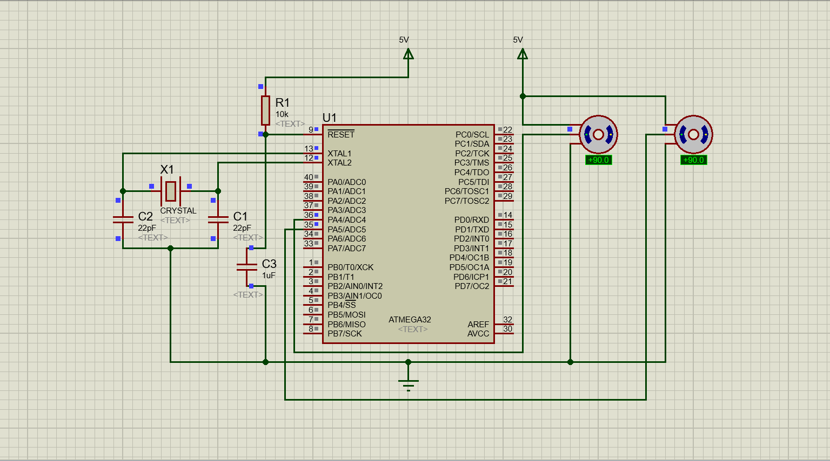
Schematic Diagram
Figure 12 – Servo motor

Slide 28
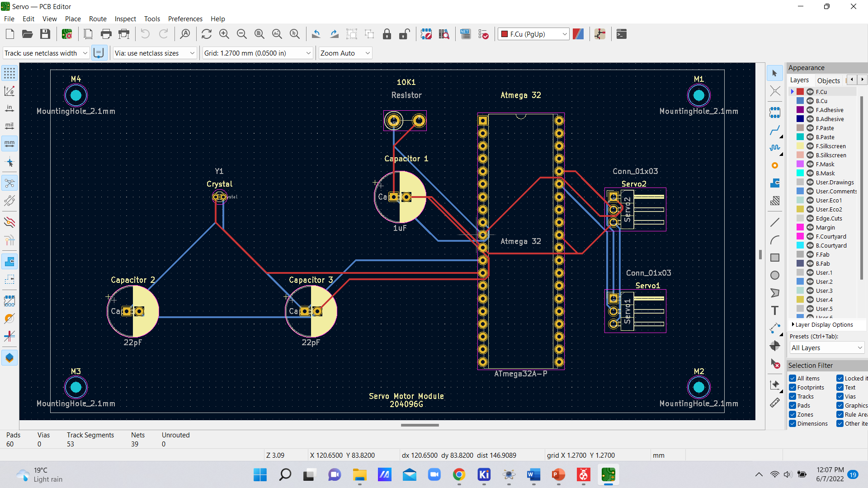
PCB Design
Figure 13 – Servo motor

Slide 29
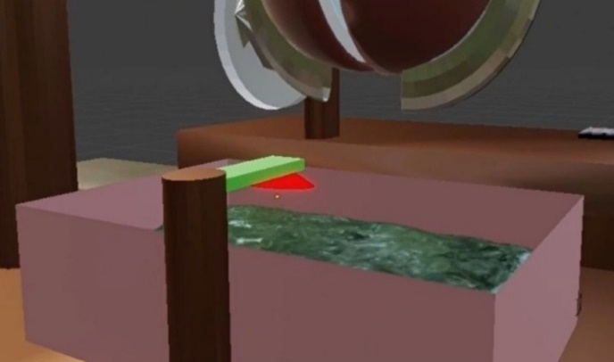
Technique - Buzzer
We use a buzzer in our machine to notify the user if the coconut water tank is full.
Based on the signal of the ultrasonic sensor it will ring.
If the ultrasonic sensor senses the water level is high, then it will send a signal through the microcontroller and the buzzer will start to ring.
I selected an active passive buzzer for our project.
Link to Datasheet: https://docs.rs-online.com/3432/A700000007927576.pdf

Slide 30
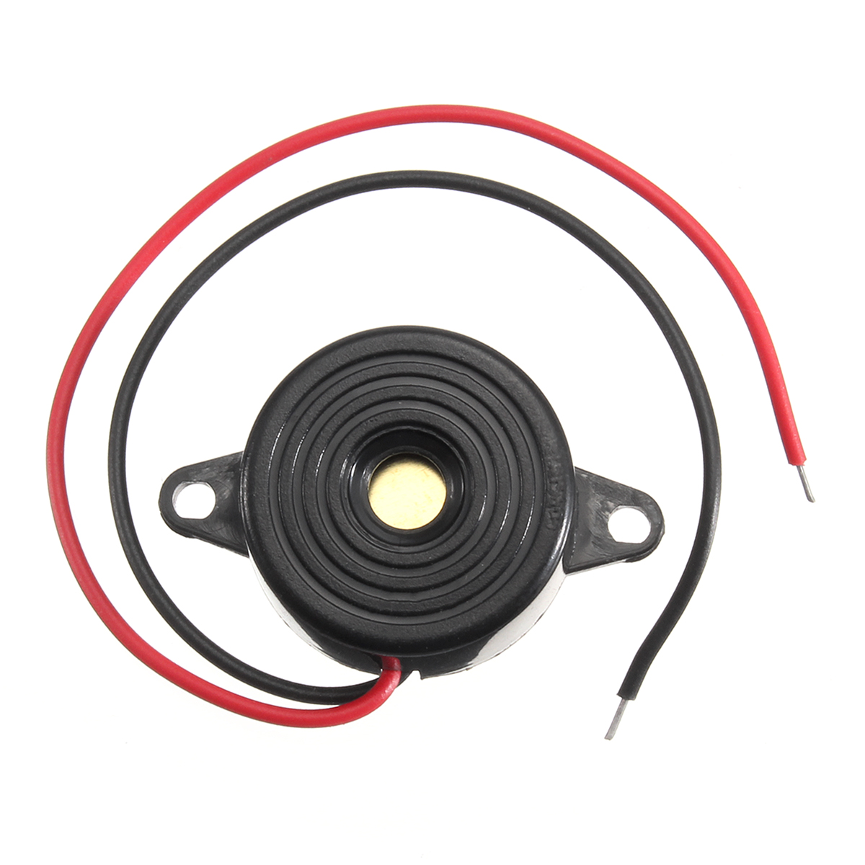
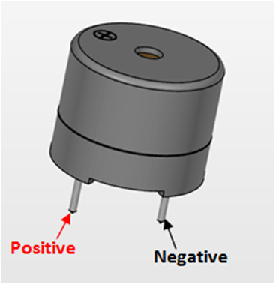
Specification
Buzzer(Active buzzer)
Rated Voltage: 6V DC
Operating Voltage: 4-8V DC
Rated current: <30mA
Sound Type: Continuous Beep
Resonant Frequency: ~2300 Hz
Small and neat sealed package
Breadboard and Perf board friendly

Slide 31
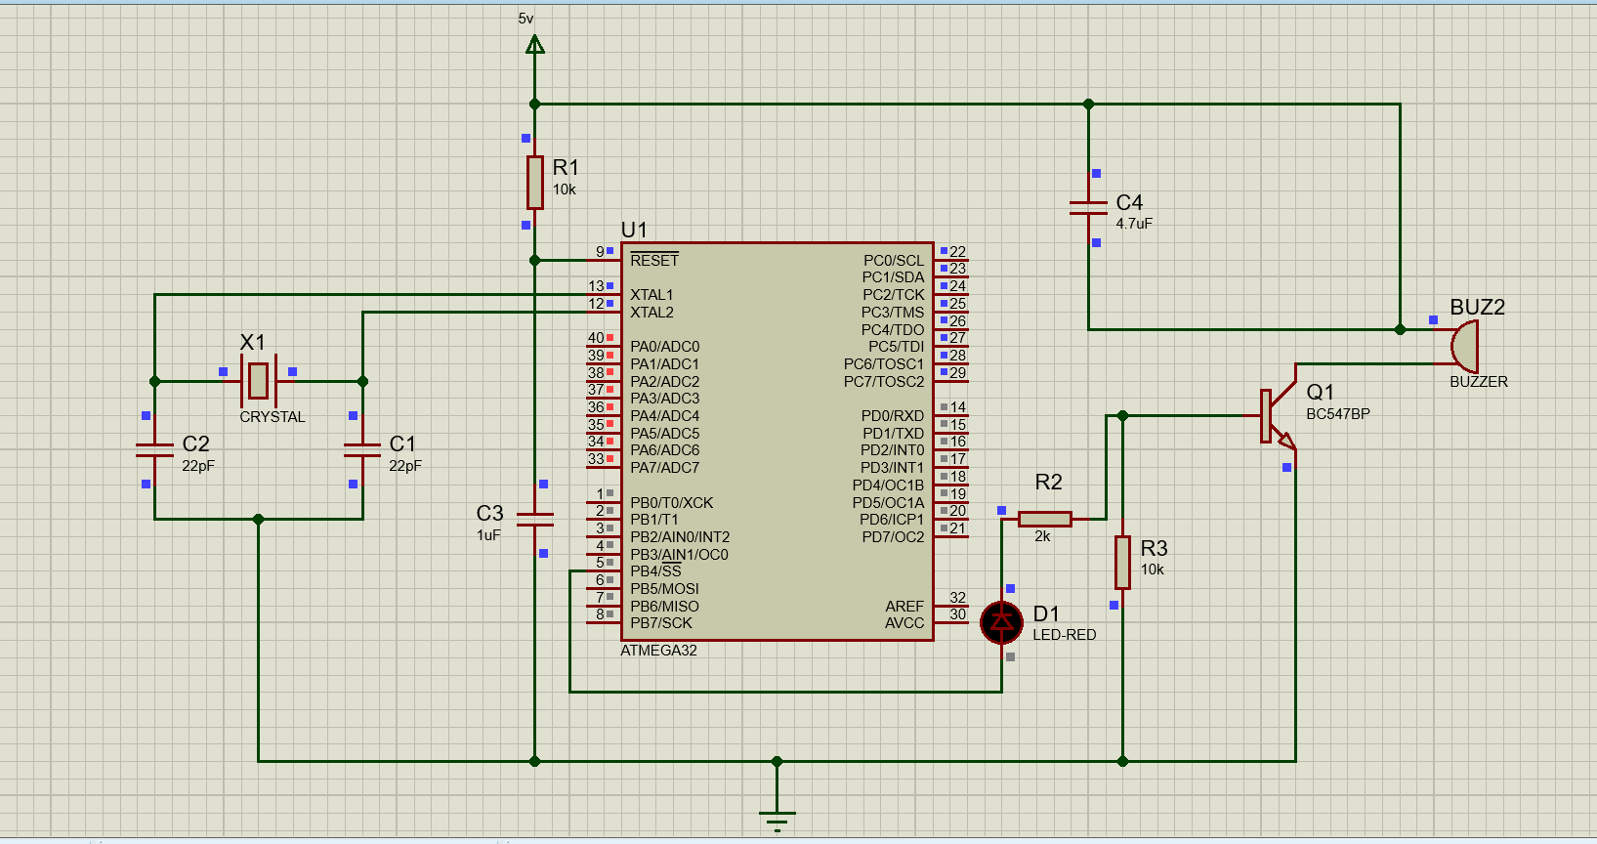
Schematic Diagram
Figure 14 – Buzzer

Slide 32
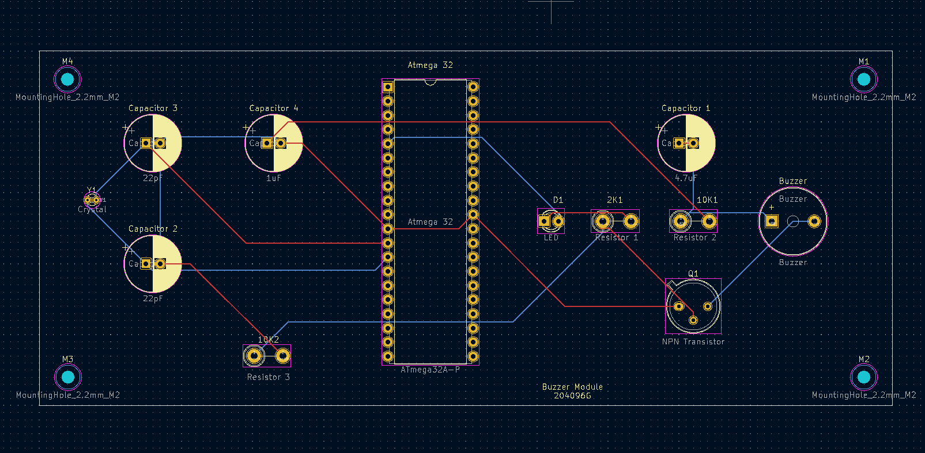
PCB Design
Figure 15 – Buzzer

Slide 33
Individual Contribution & Responsibilities
Member 3 – Banu A.G.S.(204018X)
Individual Contribution
Designing and programming the stepper motor module and power supply.
Responsibilities
To study the basic microcontroller concepts.
To study the simulation software and programming software.
To design and program stepper motor module and power supply.

Slide 34
Technique – Stepper motor
We're using a NEMA-17 stepper motor to move the cut disk.
When the stepper motor rotates clockwise the cut disk system attached to the stepper motor shaft moves down towards the coconut.
After breaking the coconut, the IR sensor gives a signal to the stepper motor, and it will rotate anti-clockwise.
Then the cut disk moves upwards to the starting position.
Link to Datasheet: https://www.omc-stepperonline.com/download/17HS08-1004S.pdf

Slide 35
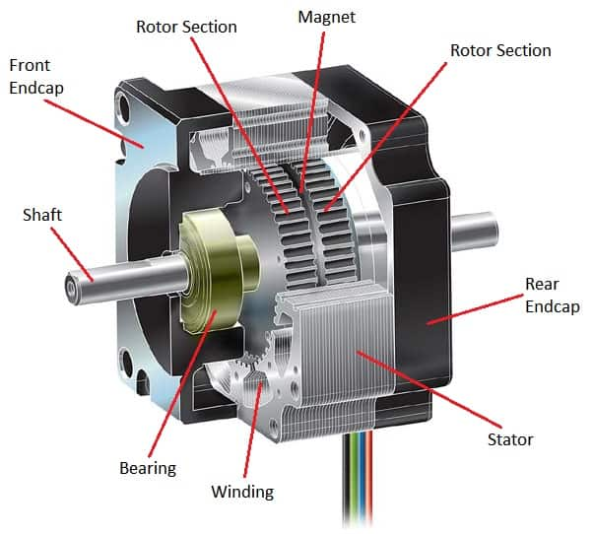
Specification
4
Stepper motor
Working voltage – 12V
Max current – 1.58A
Holding torque -6.0kg-cm(85oz-in)
step angle -200 steps/revolution
Bi-polar stepper motor

Slide 36
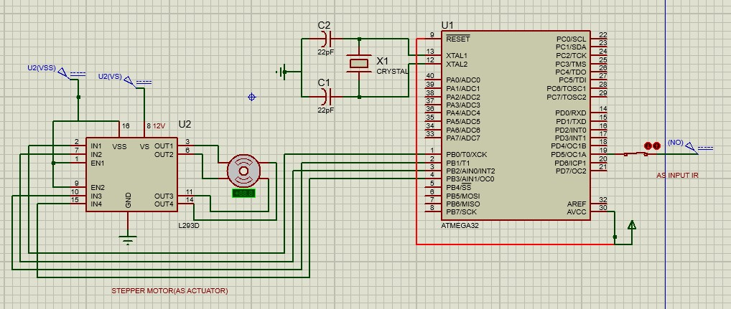
Schematic Diagram
Figure 16 – Stepper motor

Slide 37
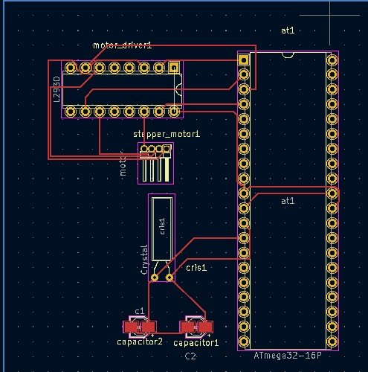
PCB Design
Figure 17 – Stepper motor

Slide 38
Technique
In our project we’re using a power supply system to power up the components.
I have used an ac step-down transformer to convert ac 240v to 20v as our system requires a maximum voltage of 12V.
Then used a rectifier circuit with 4 diodes to rectify the AC output from the transformer to DC.
The capacitor is used as a filter to remove the ripples from the rectified DC signal.
Using 7805,7812 regulators to get 5V, and 12V respectively.

Slide 39
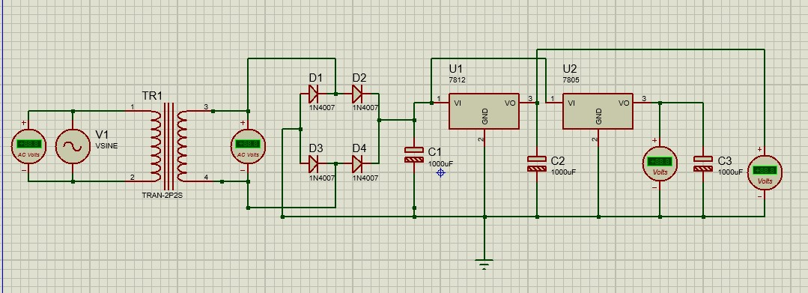
Schematic Diagram
Figure 18 – Power supply

Slide 40
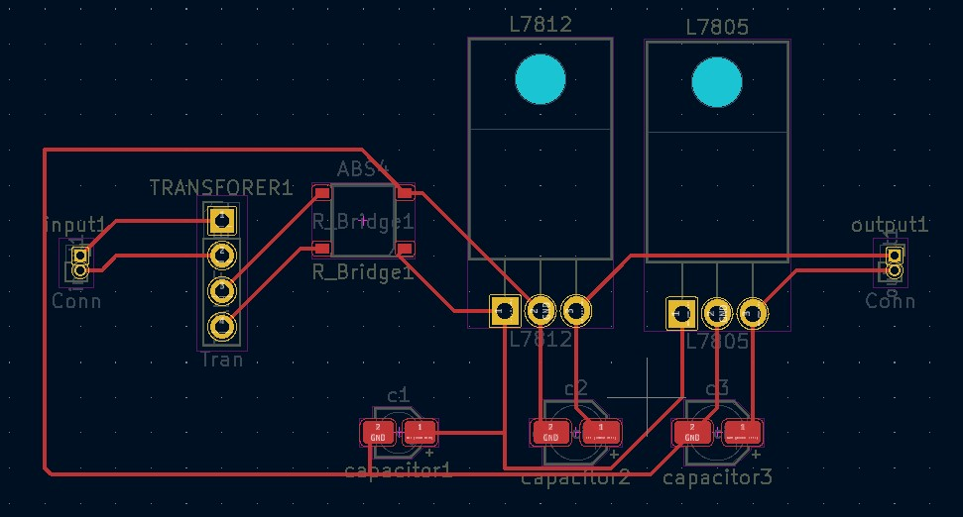
PCB Design
Figure 19 – Power supply

Slide 41
Individual Contribution & Responsibilities
Member 4 – Lamahewage D.R.(204114M)
Individual Contribution
Designing and programming the IR sensor and Keypad modules.
Responsibilities
To study the basic microcontroller concepts.
To study the simulation software and programming software.
To design and program IR sensor and Keypad modules.

Slide 42
Technique – IR Sensor
There are two LEDs. one of them emits IR Ray. And the other receives IR rays.
If that IR ray touches any surface, it reflects.
Then the reflected IR ray is caught by the IR receiver.
Then the sensor sends a signal to fulfill our need.
IR sensor is used to detect the cut disk.
Link to Datasheet: https://components101.com/sites/default/files/component_datasheet/Datasheet%20of%20IR%20%20Sensor.pdf

Slide 43
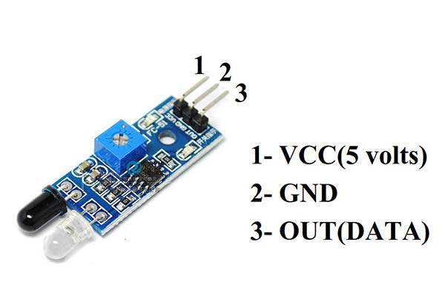
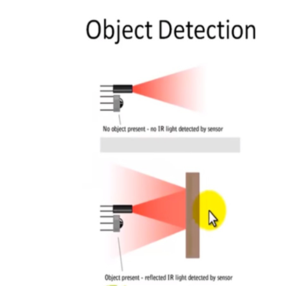
Specification
IR Sensor
Working voltage: 3.6 - 5v
Working current: 20mA
Distance range: 2cm - 30cm
Dimensions: 48 * 14 * 8 mm
Weight: 15g

Slide 44
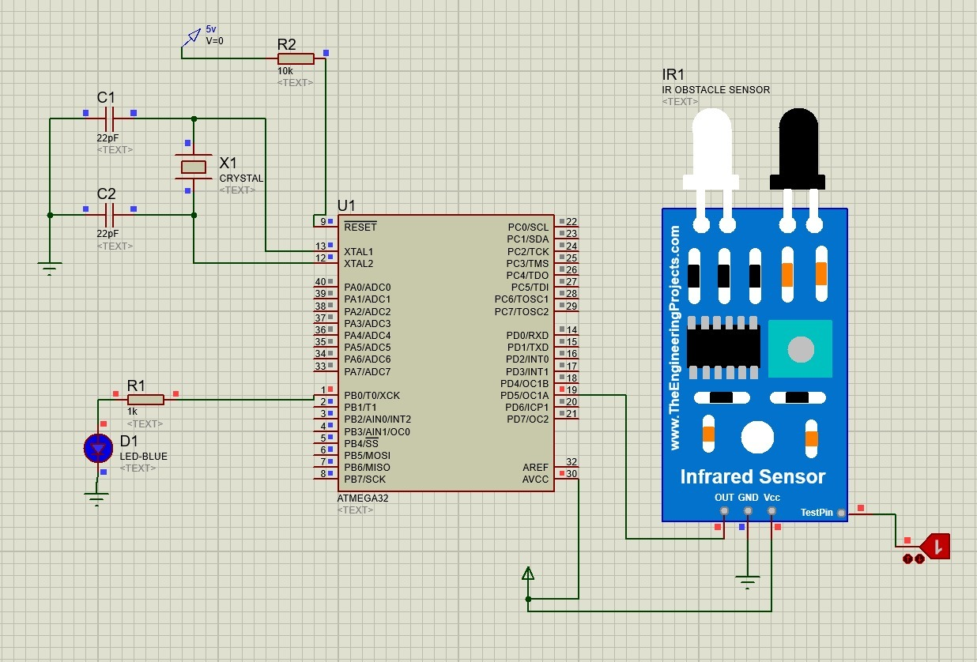
Schematic Diagram
Figure 20 – IR sensor

Slide 45
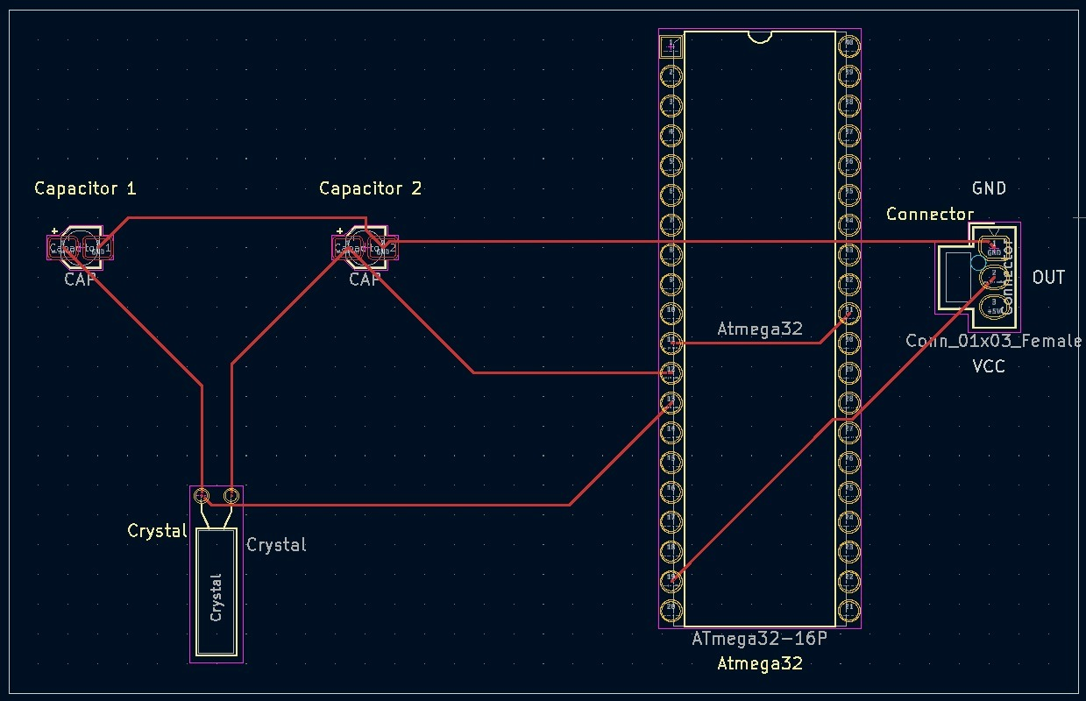
PCB Design
Figure 21 – IR sensor

Slide 46
Technique - Keypad
This is a keypad containing 12 membrane buttons that can give inputs.
Keypad is used to give inputs which should be displayed on the LCD display.
Numbers are given as inputs using the keypad.
Link to Datasheet: https://www.futurlec.com/Keypad3x4.shtml

Slide 47
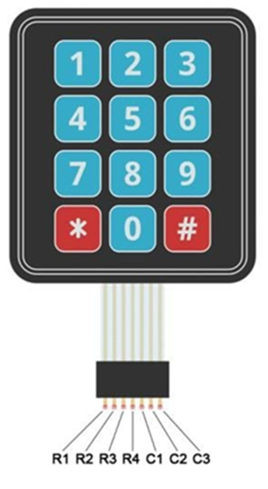
Specification
Keypad
Working voltage: 24v
Working current: 20mA
Dimensions: 9 * 8 * 4 mm
Weight: 10g
Ribbon cable length: 90mm

Slide 48
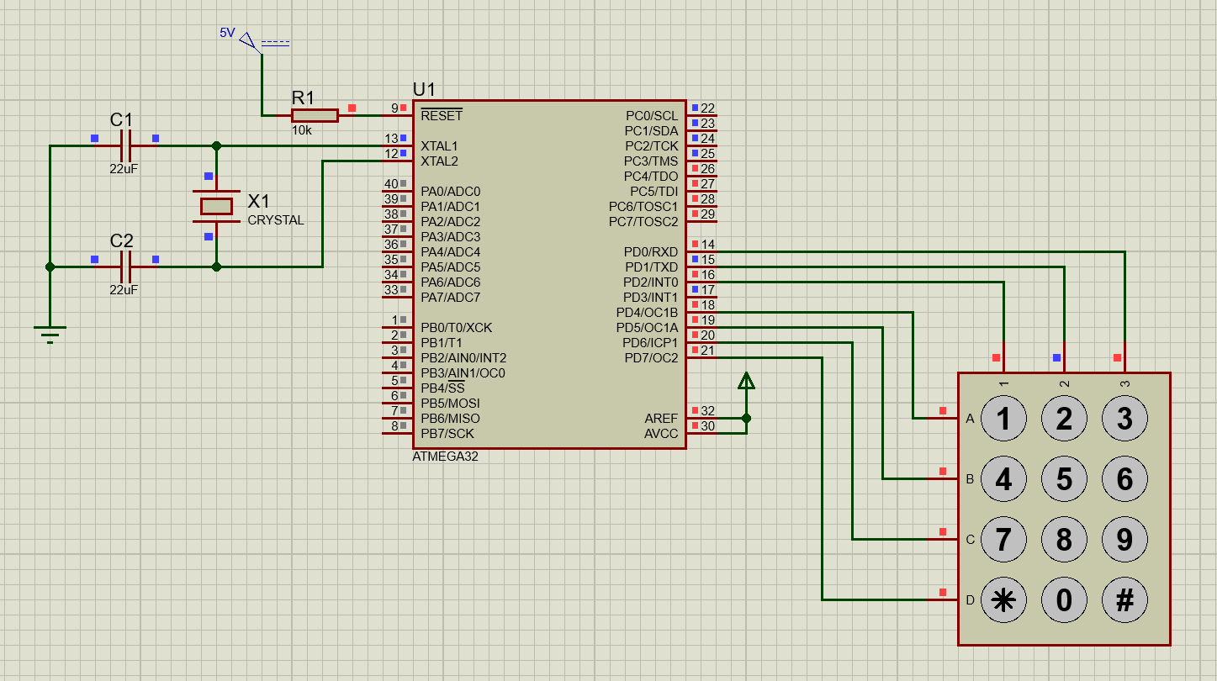
Schematic Diagram
Figure 22 – Keypad

Slide 49
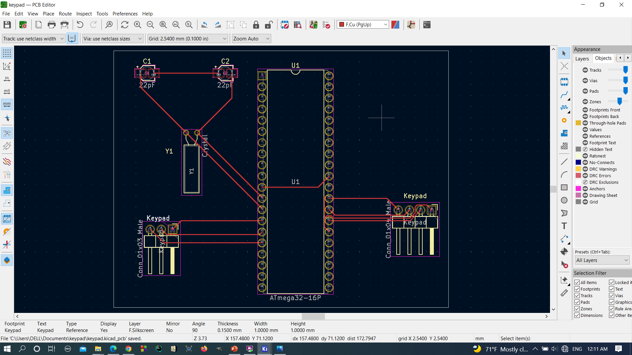
PCB Design
Figure 23 – Keypad

Slide 50
Individual Contribution & Responsibilities
Member 5 – Kumarasingha H.J.A (204108A)
Individual Contribution
Designing and programming the DC motor and Color sensor modules.
Responsibilities
To study the basic microcontroller concepts.
To study the simulation software and programming software.
To design and program DC motor and Color sensor modules.

Slide 51
Technique-DC Motor
• A DC motor converts direct current electrical energy into mechanical energy.
• The machine uses dc motors to rotate the cut disk, blender, and scrappers by 360°.
• DC shunt motor is more suitable for the scrappers because the speed of a dc shunt motor is sufficiently constant.
• Compound dc motor is more suitable for cut disk because compound motors provide high starting torque and good speed regulation.
Link to Datasheet:

Slide 52
Specification
DC Motor
● Wide Supply-Voltage Range: 4.5 V to 36 V
● Separate Input-Logic Supply
● Output Current:600 mA Per Channel
● High-Noise-Immunity Inputs

Slide 53
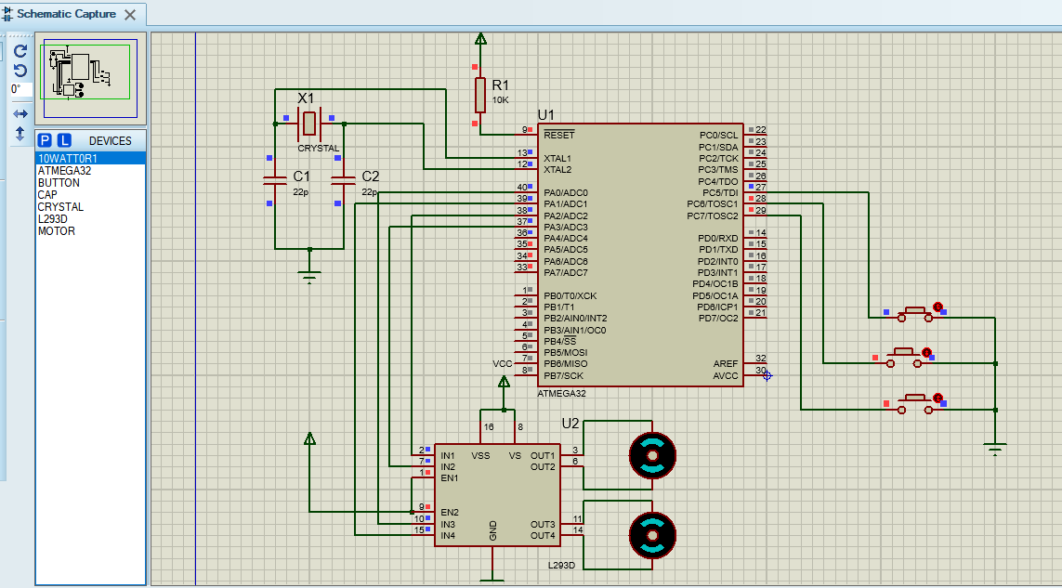
Schematic Diagram
Figure 24 – DC motor

Slide 54
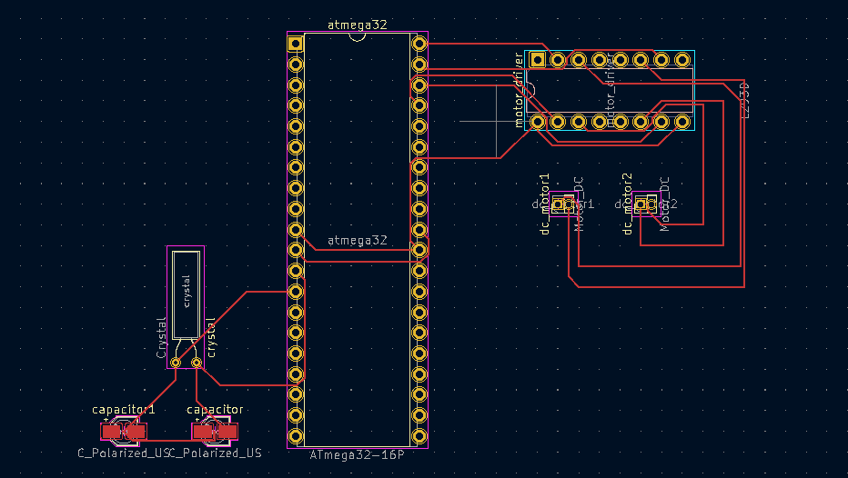
PCB Design
Figure 25 – DC motor

Slide 55
Technique – Color sensor
• It can Detect the color of an object.
Color converts the intensity of incident radiation into frequency.
• This is used to detect the color of coconut shells(brown) in the machine.
Link to Datasheet:

Slide 56
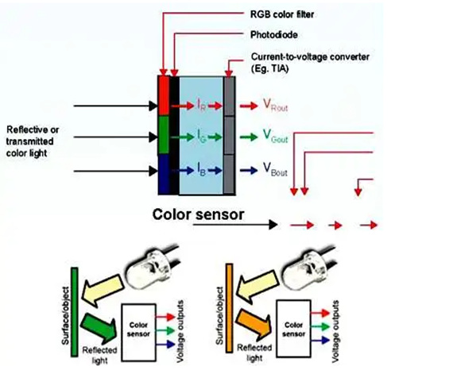
Specification
Color Sensor
● Working voltage: 2.7 - 5.5v
● Working current: 1.4 mA
● Dimension: 28.4 x 28.4 mm
● Interface: digital TTL
● Weight: 4.17g
● Programmable color

Slide 57
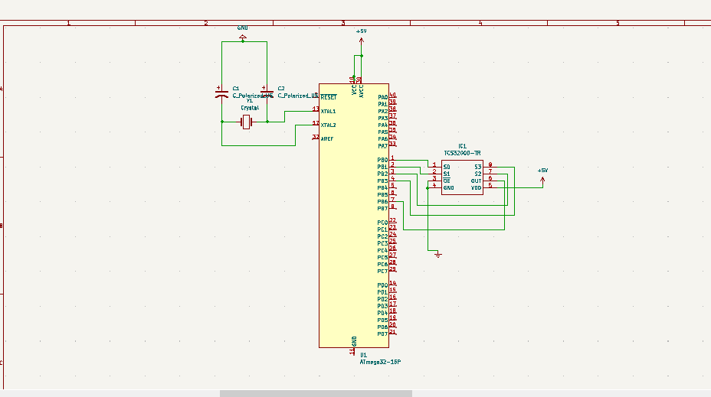
Schematic Diagram
Figure 26 – Color sensor

Slide 58
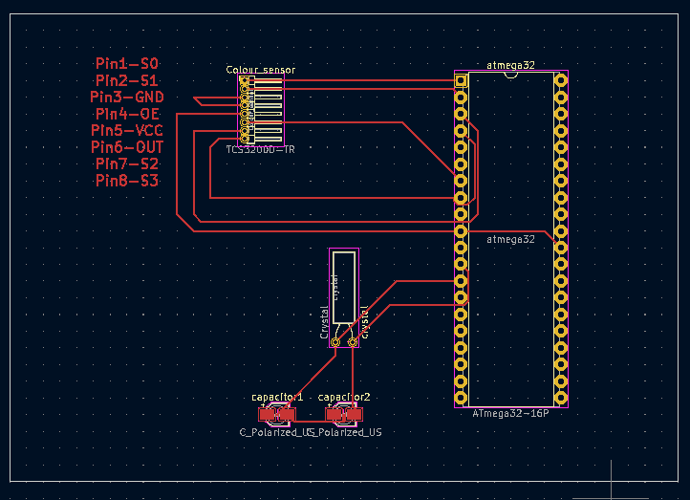
PCB Design
Figure 27 – Color sensor

Slide 59

Thank you!
Questions?

